Slide 1
CLOSING OF POLL
Distribute slips at the time fixed for close of poll to enable elector present at that time get chance to vote
Close the Control Unit and seal the machine
Accounts of votes recorded
Seal the election papers
Prepare diary and deliver the EVMs and sealed election papers at the collection centre

Slide 2
Distribute Serial Numbered Slips
Voting by persons present at polling station at closing hour
The poll should be closed at the hour fixed for the purpose, even if it had commenced later than the hour appointed.
This will not mean that after the hour fixed for closing the poll, no elector will be allowed to cast his vote
A few minutes before the hour appointed for closing the poll, announce to all those within the limits of the polling station and waiting to vote that they will be allowed to record their votes in turn
You will be supplied about 200 Pre-Printed Serial Numbered Slips (as per sample in next slide)

Slide 3
Sample Slips
SLIP (For voters in Q at closing Hr of poll) S.No. 1 [Signature (in full) of P.O.] Constituency No. ------- P.S. No. ------ | SLIP (For voters in Q at closing Hr of poll) S.No. 2 [Signature (in full) of P.O.] Constituency No. ------- P.S. No. ------
SLIP (For voters in Q at closing Hr of poll) S.No. 3 [Signature (in full) of P.O.] Constituency No. ------- P.S. No. ------ | SLIP (For voters in Q at closing Hr of poll) S.No. 4 Signature (in full) of P.O.] Constituency No. ------- P.S. No. ------

Slide 4
Declare close of poll
Voting by persons present at polling station at closing hour
Distribute to all such electors, slips signed by you in full, and serially numbered from serial No. 1(start from the last elector in the queue) onwards according to the number of electors standing in the queue.
Continue the poll until all these electors have cast their votes
Depute police or other staff to watch that no one is allowed to join the queue after the appointed closing hour
Formally declare the close of poll

Slide 5
Close the Control Unit of EVM
Press the 'Close' button on the control unit
When the 'Close' button is pressed the display panels on the control unit will show the total number of votes recorded in the voting machine till the end of the poll
Immediately record it in Item 5 of Part I of Form 17C
The rubber cap should be replaced after the 'Close' button has been pressed and the poll closed
Put the power switch to ‘OFF’ position in the rear compartment of the control unit.
Disconnect the ballot unit from the control unit
Trouble shooting - Close' button will function only when the 'Busy‘ lamp on the control unit is not on
If the 'Busy' lamp is on by mistake or otherwise, switch off the 'Power' switch in the rear compartment of the control unit and disconnecting the ballot unit(s) from the control unit
After disconnecting the ballot unit(s) from the control unit, the 'Power' should again be put 'ON'. The 'Busy' lamp will go off and the 'Close' button will become functional

Slide 6
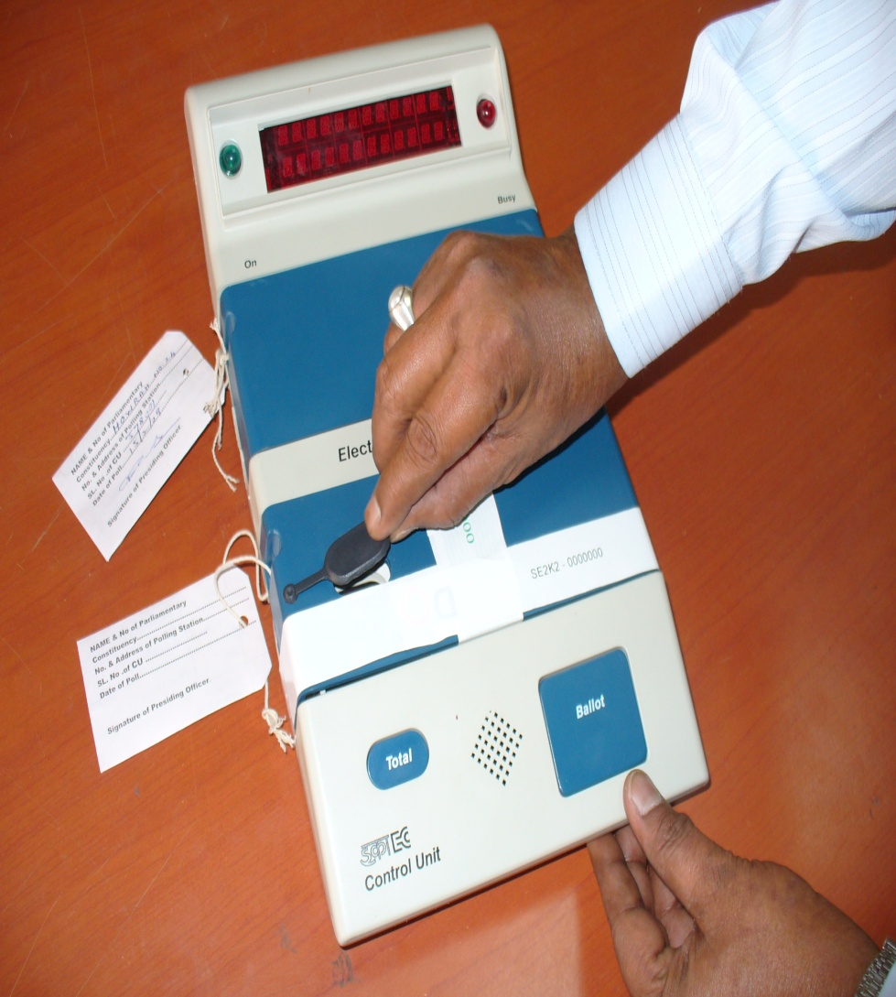
Closing and Sealing of Control Unit
After the Close of POLL, remove the cap on Close button in the Control Unit.

Slide 7
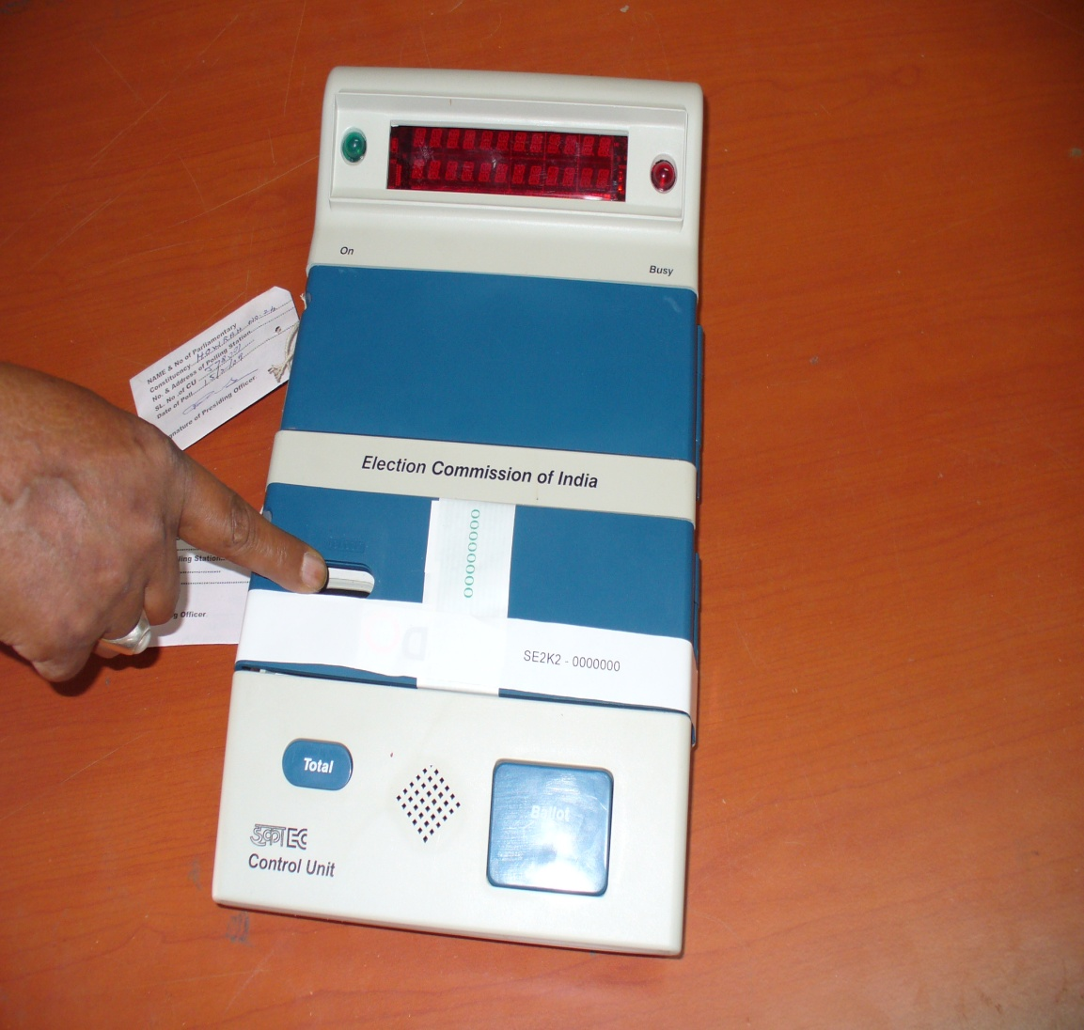
Closing and Sealing of Control Unit
Press the button as shown.
and place
Poll is closed
Fix the cap back in its
The Control unit displays total no. of votes recorded.

Slide 8
Closing the control unit of voting machine
POWER
‘OFF”
BUSY lamp OFF
Disconnect Ballot Unit
POWER
‘ON’
CLOSE Button Functional
If, BUSY Button
‘ON’
POWER
‘OFF”
Item 5 - Part I (Form 17C)
BUSY Button
‘OFF’
Record in
Disconnect Ballot Unit
CLOSE Button
Total No. of Votes recorded
Press
CONTROL UNIT
Replace ‘Rubber Cap’

Slide 9
Sealing of the EVM after close of poll
For sealing and securing the voting machine, the power switch in the control unit should first be switched 'OFF'
Then the ballot unit(s) and the control unit should be disconnected.
The ballot unit(s) and the control unit should now be put back in their respective carrying cases
Each carrying case should then be sealed at both ends by passing a thread through the two holes provided for the purpose on both sides of the carrying case
Putting thread, seal with an address tag showing the particulars of the election, the polling station and the unit contained therein

Slide 10
….Continued
Signature of Presiding officer and seal it
Ask putting seal by the contesting candidates or their polling agents, who are present at the polling station
Note the name of those who affix their seal on carrying cases of ballot units and control unit as above in declaration (Given in next slide)

Slide 11
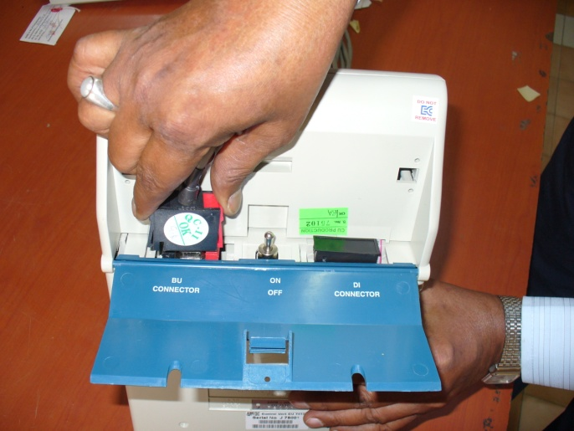
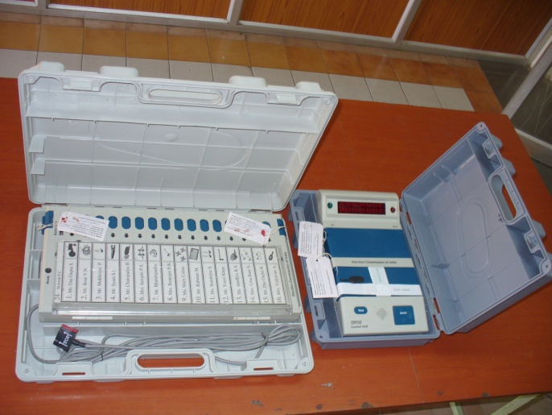
Closing and Sealing of Control Unit
Open the bottom compartment of the Control Unit and Switch OFF Power and disconnect the interconnecting cable
Pack the Control unit (with the Strip seal) and Balloting Unit in their carrying cases

Slide 12
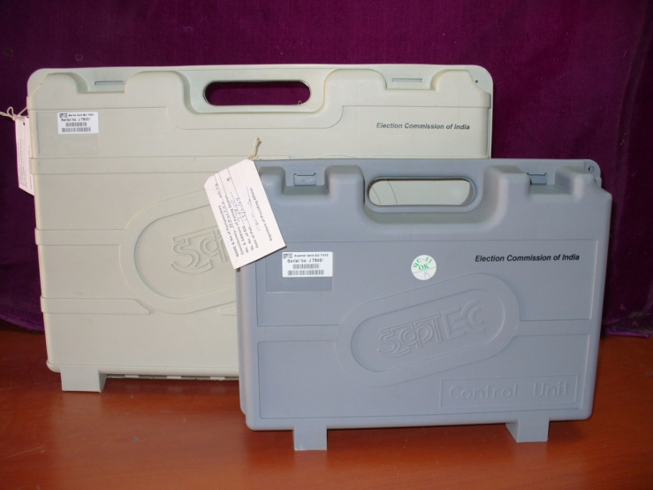
Closing and Sealing of Control Unit
Seal the carrying cases and fix address tags.

Slide 13
Declaration of sealing EVM

Slide 14
Sealing of the voting machine after close of poll
Control Unit
Disconnect
Switch OFF
Ballot Unit
Control Unit
Putting in respective carrying cases
Sealing both ends
Thread in both holes
Ballot Unit
Noting of Name sealing cases
PrO
Address Tags
Seal
Signature
of PrO
Candidate/
Polling Agent
Election particulars
Units
Control Unit
Polling station

Slide 15
Account of votes recorded
Preparation of account of votes recorded
Under rule 49S of the Conduct of Elections Rules, 1961, an account of votes recorded in the voting machine shall be prepared by you in Part I of Form 17C in duplicate
Total number of votes recorded in voting machine = total number of voters registered as per column (I) of the Register of Voters (Form 17A) – (the number of voters who decided not to vote+ the number of voters not allowed by you to vote)
In the following slide Part I of Form 17C is given for your guidance at (Annexure XIII) as sample
The account of votes recorded in Form 17C should be kept by you in a separate cover with the words 'Account of Votes Recorded' super scribed therein

Slide 16
Account of votes recorded

Slide 17
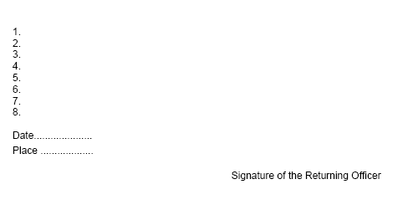
…Continued

Slide 18
Supply copies to the polling agents
Supply of attested copies of account of votes recorded to polling agents & Declaration at the close of poll
As per Rule 49S, you are also required to furnish to every polling agent, who is present at the close of the poll, a true attested copy of the account of votes recorded as prepared by you in Form 17C, after obtaining a receipt from those polling agents.
Copies of the accounts should be furnished to every polling agent present even without his asking for it.
The original Form 17C has to be deposited at the Collection Centre (Strong Room) along with the voting machine.
The duplicate copy of Form 17C will also be deposited at the Collection Centre

Slide 19
Supply to the polling agents
Supply of attested copies of account of votes recorded to polling agents & Declaration at the close of poll
If possible, you should prepare the required number of copies with the help of carbon paper, while filling in the entries in the original account so that all polling agents and the original account are identical in every respect
For simultaneous election separate copies should be prepared and given respectively following above procedure
To ensure following of rule 49S Commission has devised a declaration (Given in next slide) which should be made and completed by you at the close of poll

Slide 20
Supply to the polling agents

Slide 21
Sealing of election papers
All the packets sealed, except the packets containing. These have to be kept in a separate cover
The account of votes recorded and paper seal (in Form 17C),
The declarations by the Presiding Officer before the commencement of poll, during the poll and after close of poll (Given in next to next slide)
The Presiding Officer's Diary,
Visit Sheet and the 16-Point Observer’s Report should be put in four large packets as explained in paragraph 3 below and sent to the Returning Officer.

Slide 22
Sealing of election papers
This Cover contains
The account of votes recorded and paper seal account
The declarations by the Presiding Officer
The Presiding Officer's Diary
Visit Sheet and the 16-Point Observer’s
Report should be sent separately along with the voting machine to the receiving centre

Slide 23
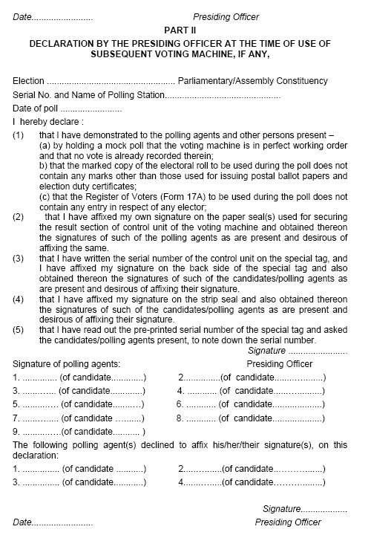
Declaration of Sealing of election papers

Slide 24
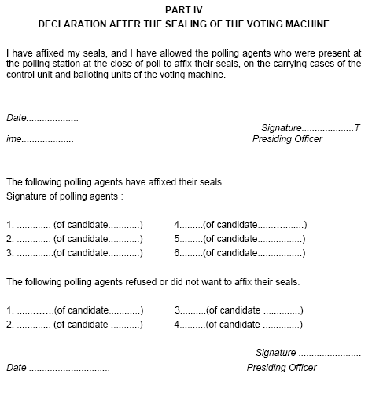
Declaration of Sealing of election papers

Slide 25
Packet 1 – Statutory Covers
The first packet should contain the sealed covers mentioned below and should be super scribed as "STATUTORY COVERS":
The sealed cover containing the marked copy of the electoral roll;
The sealed cover containing the register of voters;
The sealed cover containing voter's slips;
The sealed cover containing unused tendered ballot papers;
The sealed cover containing the used tendered ballot papers and the list in Form 17B.

Slide 26
Please note!!
Even if a statement or record to be put in any cover mentioned above is nil, a slip noting on it that the statement or record is "Nil" may be put in the cover and the total number of five covers made ready so that no necessity arises for the receiving official at the receiving centre to enquire about the nonproduction of any of the seal

Slide 27
Packet 2 – Non-statutory Covers 1/2
The second packet should contain the following covers and should be super scribed as "NON-STATUROTY COVERS":
The cover containing the copy or copies of electoral roll (other than the marked copy);
The cover containing the appointment letters of polling agents in Form 10;
The cover containing the election duty certificate in Form 12- B;
The sealed cover containing the list of challenged votes in Form14;
The cover containing the list of blind and infirm electors in Form 14-A and the declarations of the companions;
The cover containing the declarations obtained from electors a to their age and the list of such electors – (Given in next slide)

Slide 28
Declaration of age by voters

Slide 29
Packet 2 – Non-statutory Covers 2/2
The second packet should contain the following covers and should be super scribed as "NON-STATUROTY COVERS
Cover containing the receipt book and cash, if any, in respect of challenged votes;
Cover containing unused and damaged paper seals;
Cover containing unused voter's slips
Cover containing unused and damaged special tags; and
Cover containing unused and damaged strip seals

Slide 30
Packet 3 – Miscellaneous
The third packet should contain the following items
The Handbook for Presiding Officer
Manual of Electronic Voting Machine
Indelible ink set (with stopper having been secured on each phial effectively with molten candle or wax applied thereon to prevent leakage or evaporation)
Self-inking pads;
The metal seal of the Presiding Officer;
The arrow cross-mark rubber stamp for marking tendered ballot papers
Cup for setting the indelible ink.

Slide 31
Packet 4
The fourth Packet should contain all the other items, if any.

Slide 32
Seal of Candidates/their election Agents/Polling Agents
on envelops & packets containing:
Marked copy of electoral roll;
The register of voters;
Voter's slips;
The used tendered ballot papers and the list of tendered votes in Form 17B;
The unused tendered ballot papers;
The list of challenged votes;
The unused and damaged paper seals, if any;
Appointment letters of polling agents; and
Any other papers that the Returning Officer has directed to be kept in a sealed packet.

Slide 33
Sealing of election papers - Summary
Each of the five smaller covers/packets to be included in the first packet marked “STATUTORY COVERS” should be sealed.
The other smaller covers/packets containing various non-statutory papers and items of election materials to be included in the second, third and fourth packets marked "NONSTATUTORY COVERS" may be prepared separately, but need not be sealed (except the cover containing the list of challenged votes in Form 14) in order to save time.
- All these unsealed covers and the sealed cover, containing list of challenged votes in Form 14, should simply be placed in the respective bigger covers along with a check memo signed by you.
- These three bigger packets i.e 2nd, 3rd and the 4th need not be sealed; but may be properly secured by means of pins or thread so that the contents may be checked at the collection centres.
The first packet marked "Statutory Covers" should, however, be sealed by you after checking of the contents at the collection centre

Slide 34
Preparation of the PrO’s diary
The Presiding Officer should record the proceedings connected with the poll in the diary with serially numbered proforma. (Annx-XIV)
You must go on recording the relevant events as and when they occur.
You should mention all important events carefully while recording as if any incident at the polling station, which is not reported by you, but is reported by any other source, the Election Commission shall take necessary action in the matter. The Election Commission may even contemplate taking disciplinary action against you.
Keep on making necessary entries in the relevant columns of the diary at regular intervals and not do all entries and complete the diary at the end of the poll as it is highly objectionable.

Slide 35
To the Collection Centres
Transmission of Voting machine and election papers to the returning officers
The voting machine and the election papers should be delivered or caused to be delivered at the collection centre with Zero delay.
Any delay in this behalf will be viewed by the Commission with utmost concern and will invite severe disciplinary action against all concerned

Slide 36
Items to be handed over 1/2
You will hand over to the Official-in-charge of the collection centre the following 13 items of election records and materials and obtain a receipt
The control unit and ballot unit(s) of the voting machine duly sealed in their respective carrying cases;
The cover containing the account of votes recorded and paper seal account (Form 17C);
The cover containing the declarations of the Presiding Officer;
The cover containing the Presiding Officer's diary;
Visit Sheet
16-Point Observer’s Report

Slide 37
Items to be handed over 2/2
7. The first packet super scribed “STATUTORY COVERS “ (containing 5 covers)
The second and third packets containing other election materials;
Material for voting compartment;
Lantern, if supplied;
Waste paper basket;
Polythene bag/gunny bag to carry polling materials; and
Fourth packet containing all other items, if any.

Slide 38
THANKS

