Slide 1
Learning Objective: To ensure carrying out Vulnerability Mapping
[ECI No. 464/INST/2007 - PLN-I dt. 12.10.2007] and
464/Instructions/EPS/Dt. 5th March, 2011

Slide 2
Learning Objective : To ensure carrying out Vulnerability Mapping
1
To be able to answer What is Vulnerability
2
To be able to answer What is Vulnerability Mapping
3
To list the personnel involved in & Process of Vulnerability Mapping
4
To list the Information requisite for Vulnerability Mapping
5
To list criteria for identifying Critical Polling Stations
6
To list steps of Response Protocol at Critical Polling Stations

Slide 3
Sub Learning Objective 1: Definition of Vulnerability
Vulnerability as defined by ECI
susceptibility of any voter or section of voters, whether or not living in a geographically identifiable area,
to be fully prevented from or influenced upon in relation to the exercise of his right to vote in a free and fair manner,
through intimidation or use of undue influence or force of any kind on him/her.

Slide 4
Sub Learning Objective 2: Definition of Vulnerability Mapping
To clearly identify vulnerable voters/sections of voters
To identify the persons/ factors causing such vulnerability and
To plan and take adequate corrective action well in advance.

Slide 5
Sub Learning Objective 3: Personnel & Process of Vulnerability Mapping
Sector Officers collect requisite information
DEO & SP finalize the Vulnerability mapping report and develop & initiate preventive measure
RO compiles information for entire constituency, polling stations wise
Local SHO/BDO consulted before finalizing
SOs submit information to RO

Slide 6

Sub Learning Objective 4: To list the Information requisite for Vulnerability Mapping
( 464/Instruction/EPS/2011 dated 5th March, 2011)
Identification by SO of vulnerable areas/communities by visiting catchment area of respective polling stations
Meetings with community, local intelligence, etc.
Identify source of threat and intimidation
Identify names of people who are likely to start such offence of undue influence
Take into account past incidences and current apprehensions
Finalize in consultation with SHO, BDO, Tehsildar
Identify point of contact within the community so that information related to such incidences can be tracked immediately
Polling Station wise lists shall be prepared

Slide 7
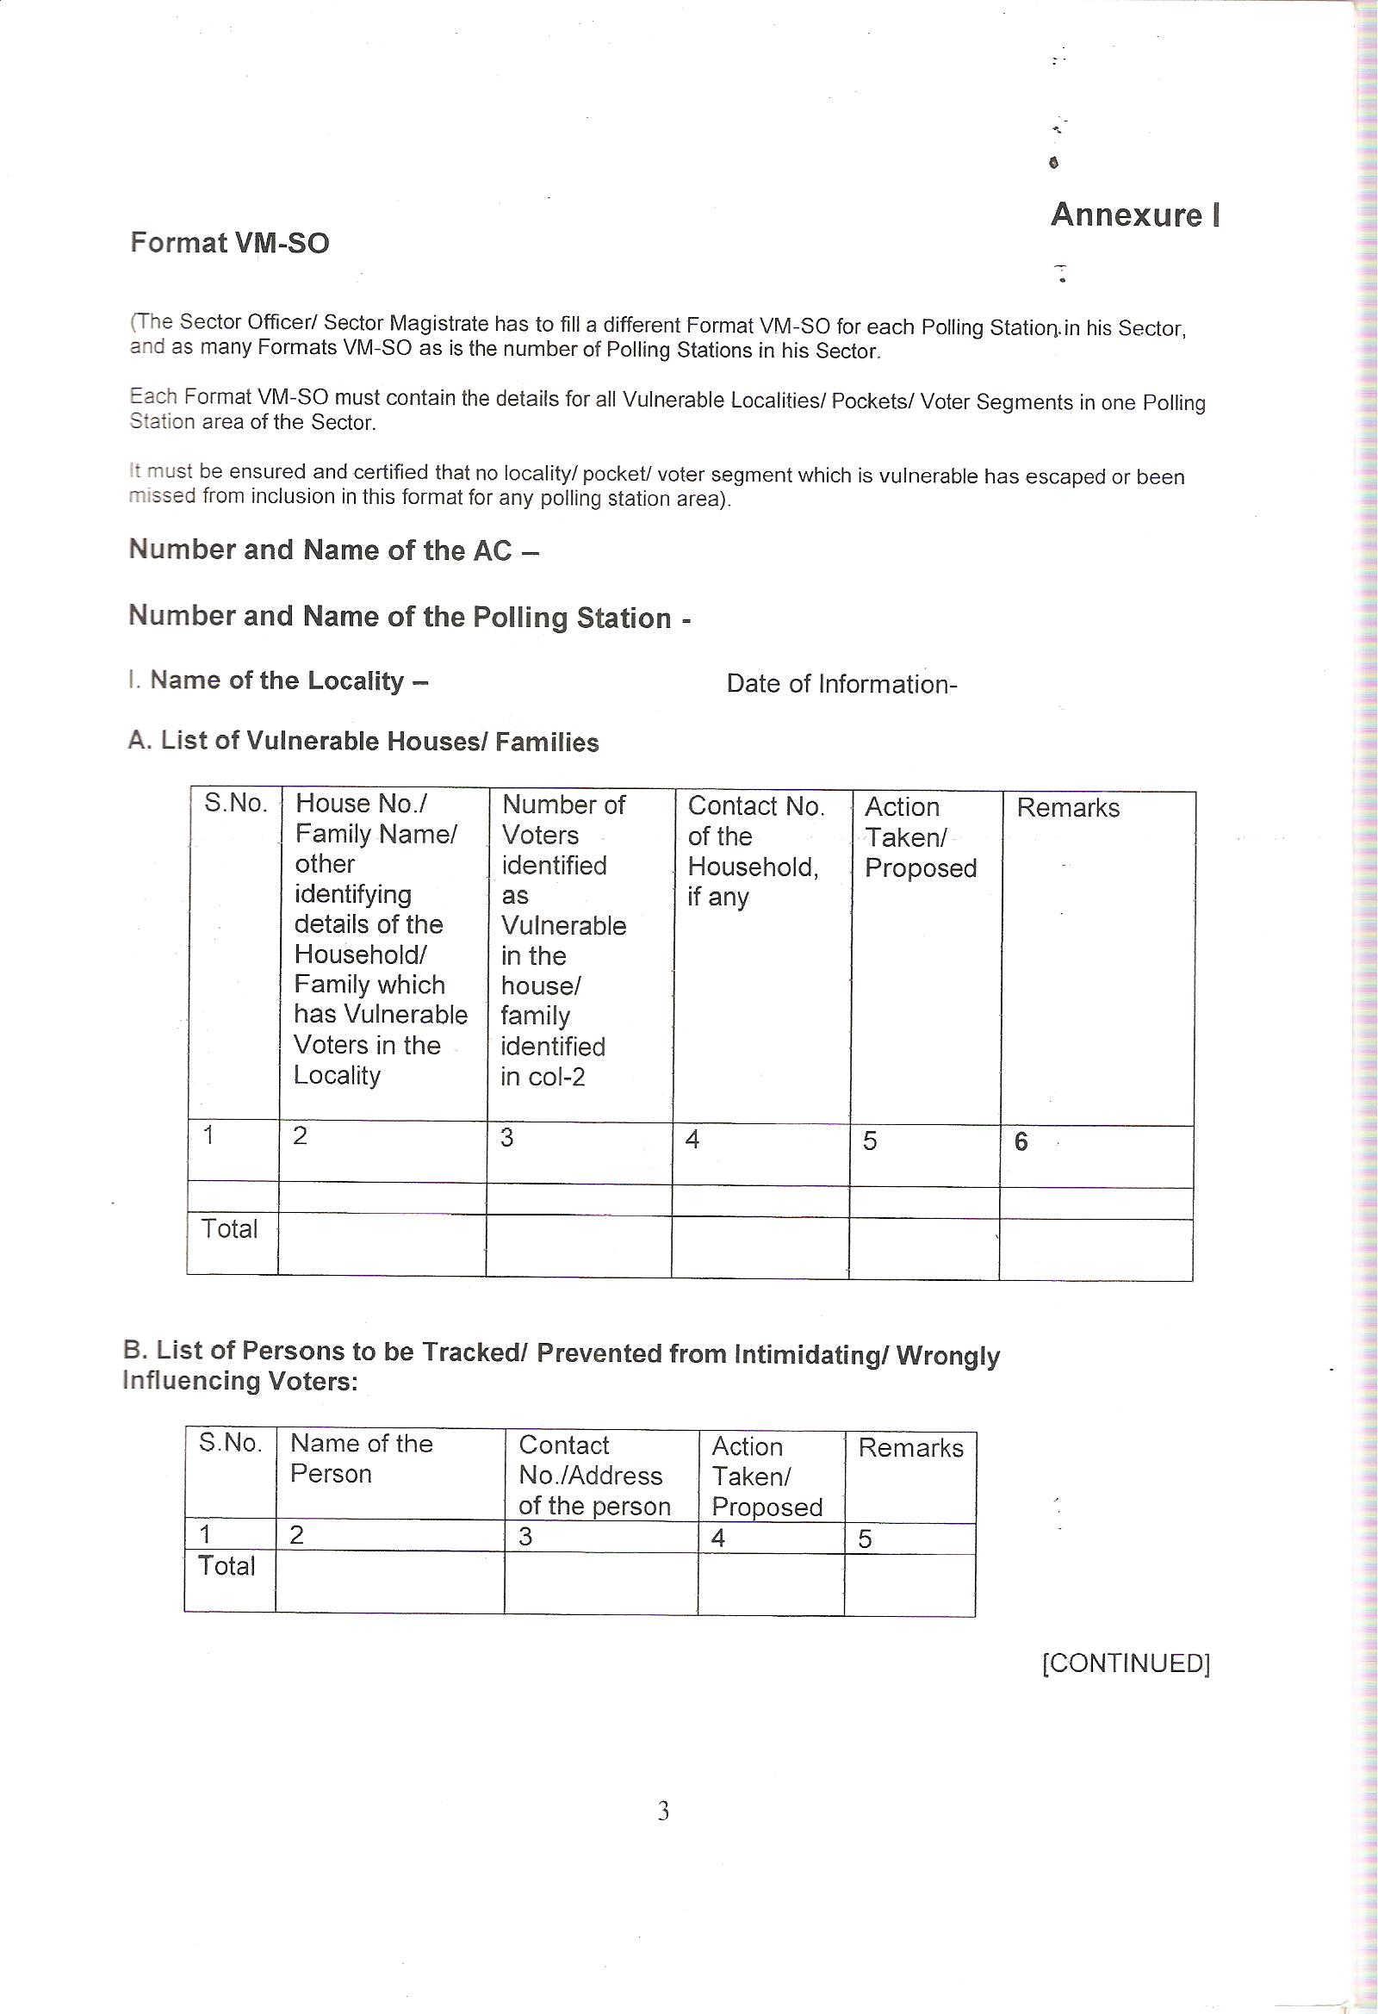
Sub Learning Objective 4: To list the Information requisite for Vulnerability Mapping
Format for Submitting Information by SO to RO for each locality/ Pocket – Annexure I - Additional Instructions
Action Taken/Proposed for identified vulnerable houses/families
Action Taken/Proposed against identified persons causing vulnerability

Slide 8
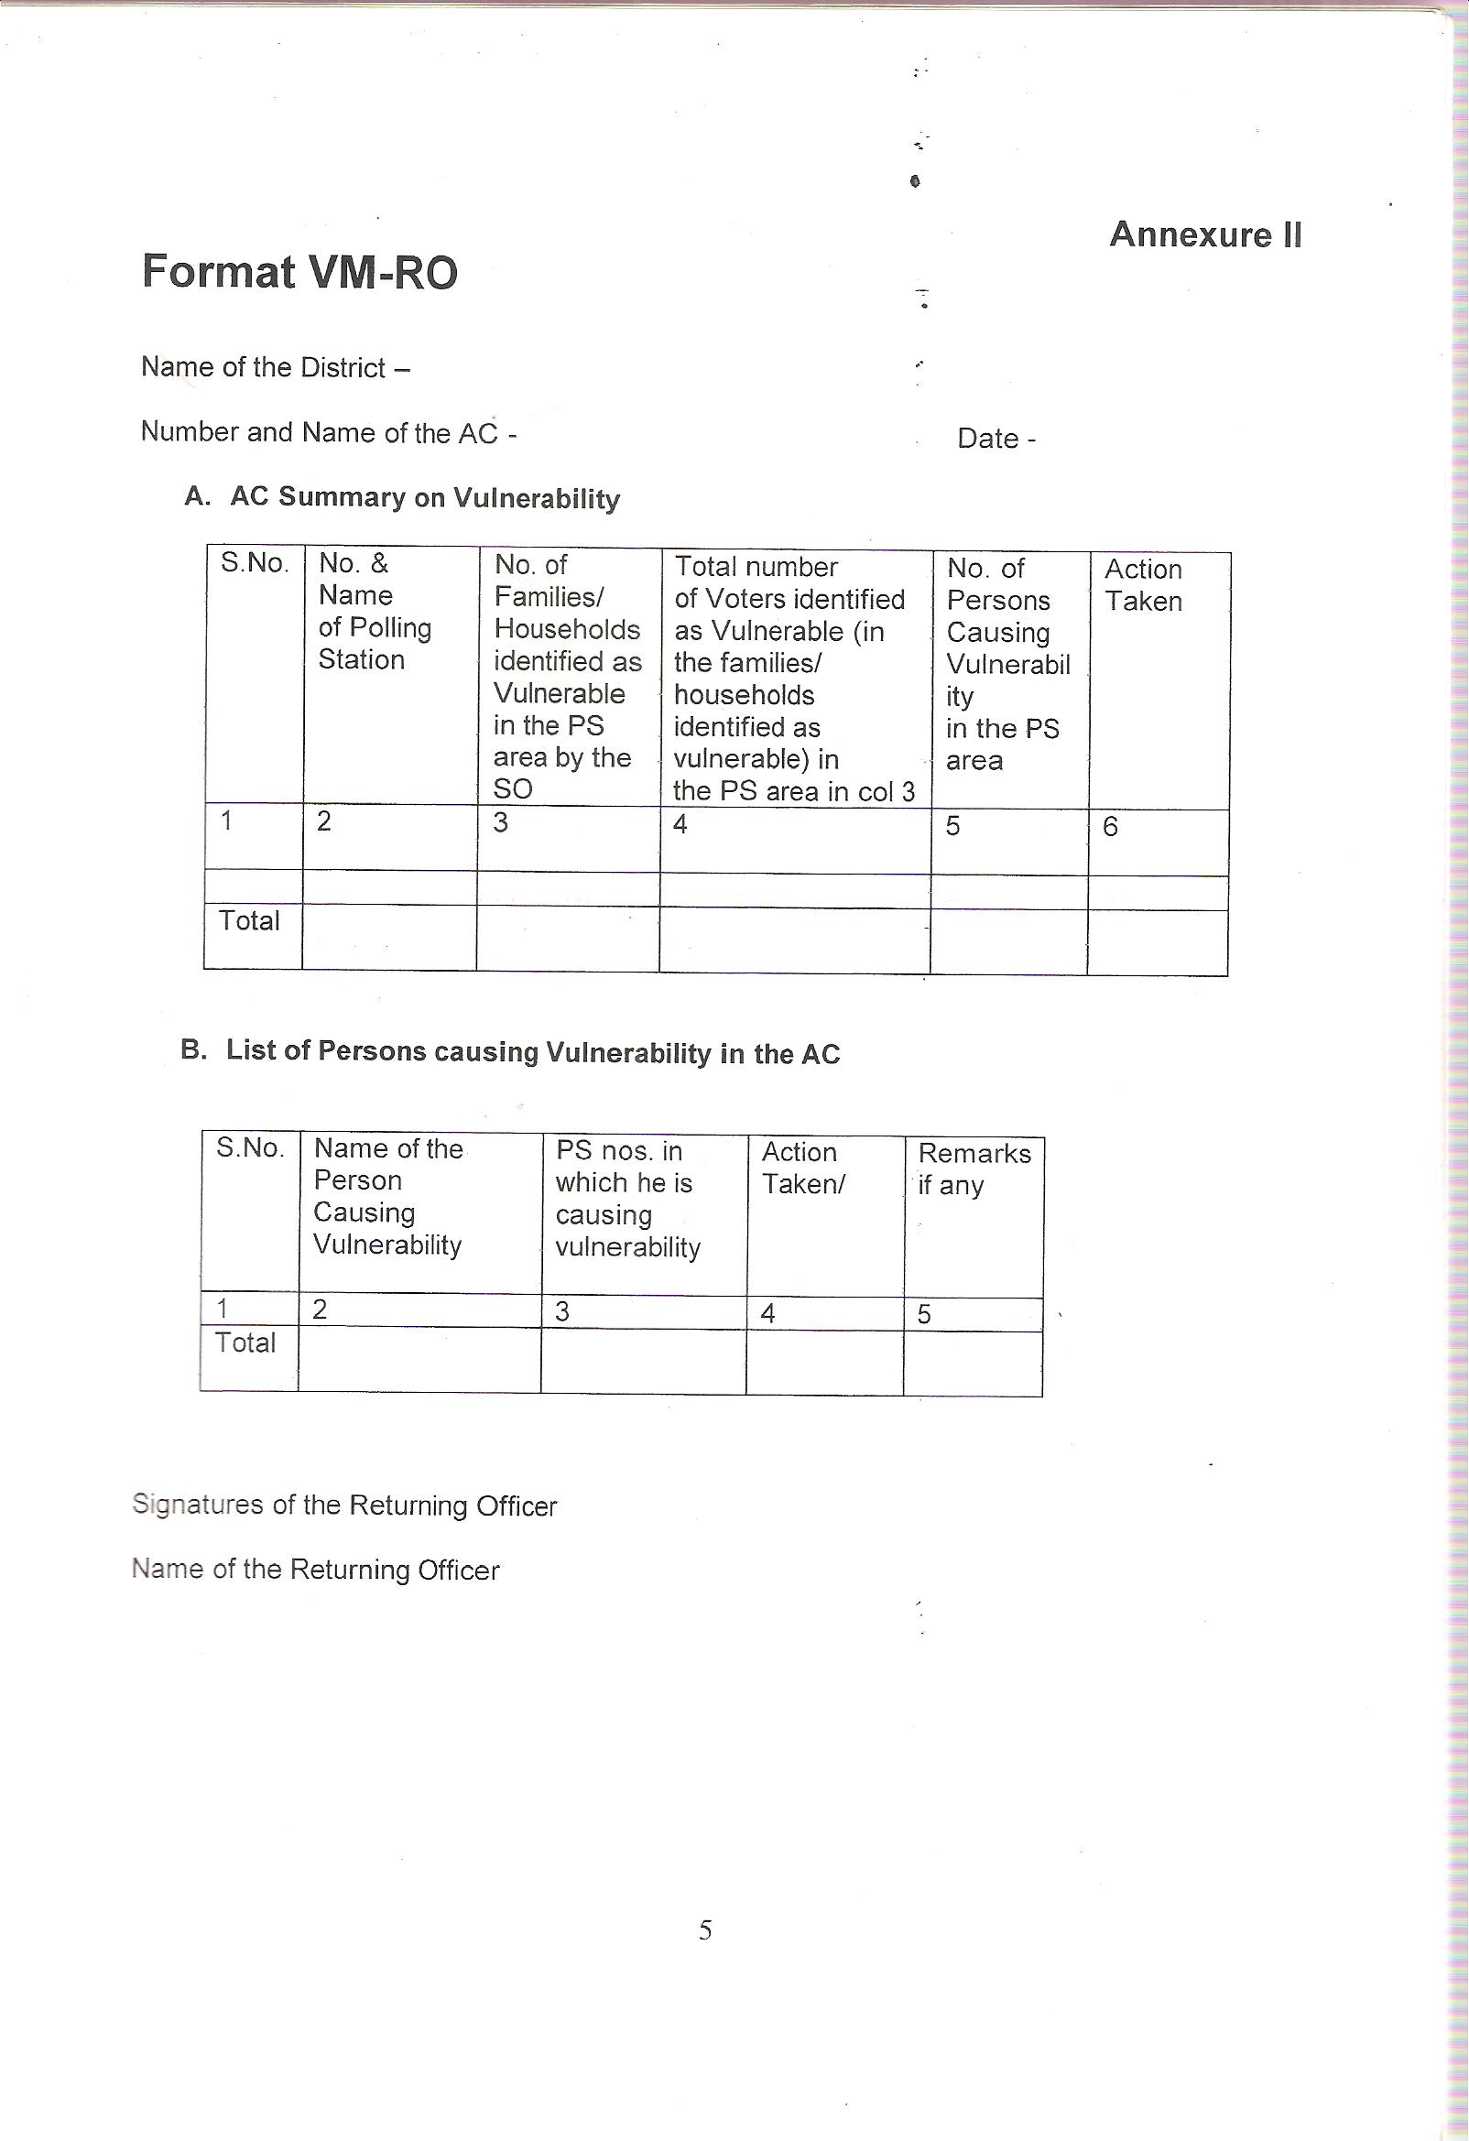
Sub Learning Objective 4: To list the Information requisite for Vulnerability Mapping
Format for Submitting Information by RO to DEO for AC- Annexure II: Additional Instructions
No. of Vulnerable Families/HHs Identified
Action Taken/Proposed for identified vulnerable houses/families
Action Taken/Proposed against identified persons causing vulnerability

Slide 9
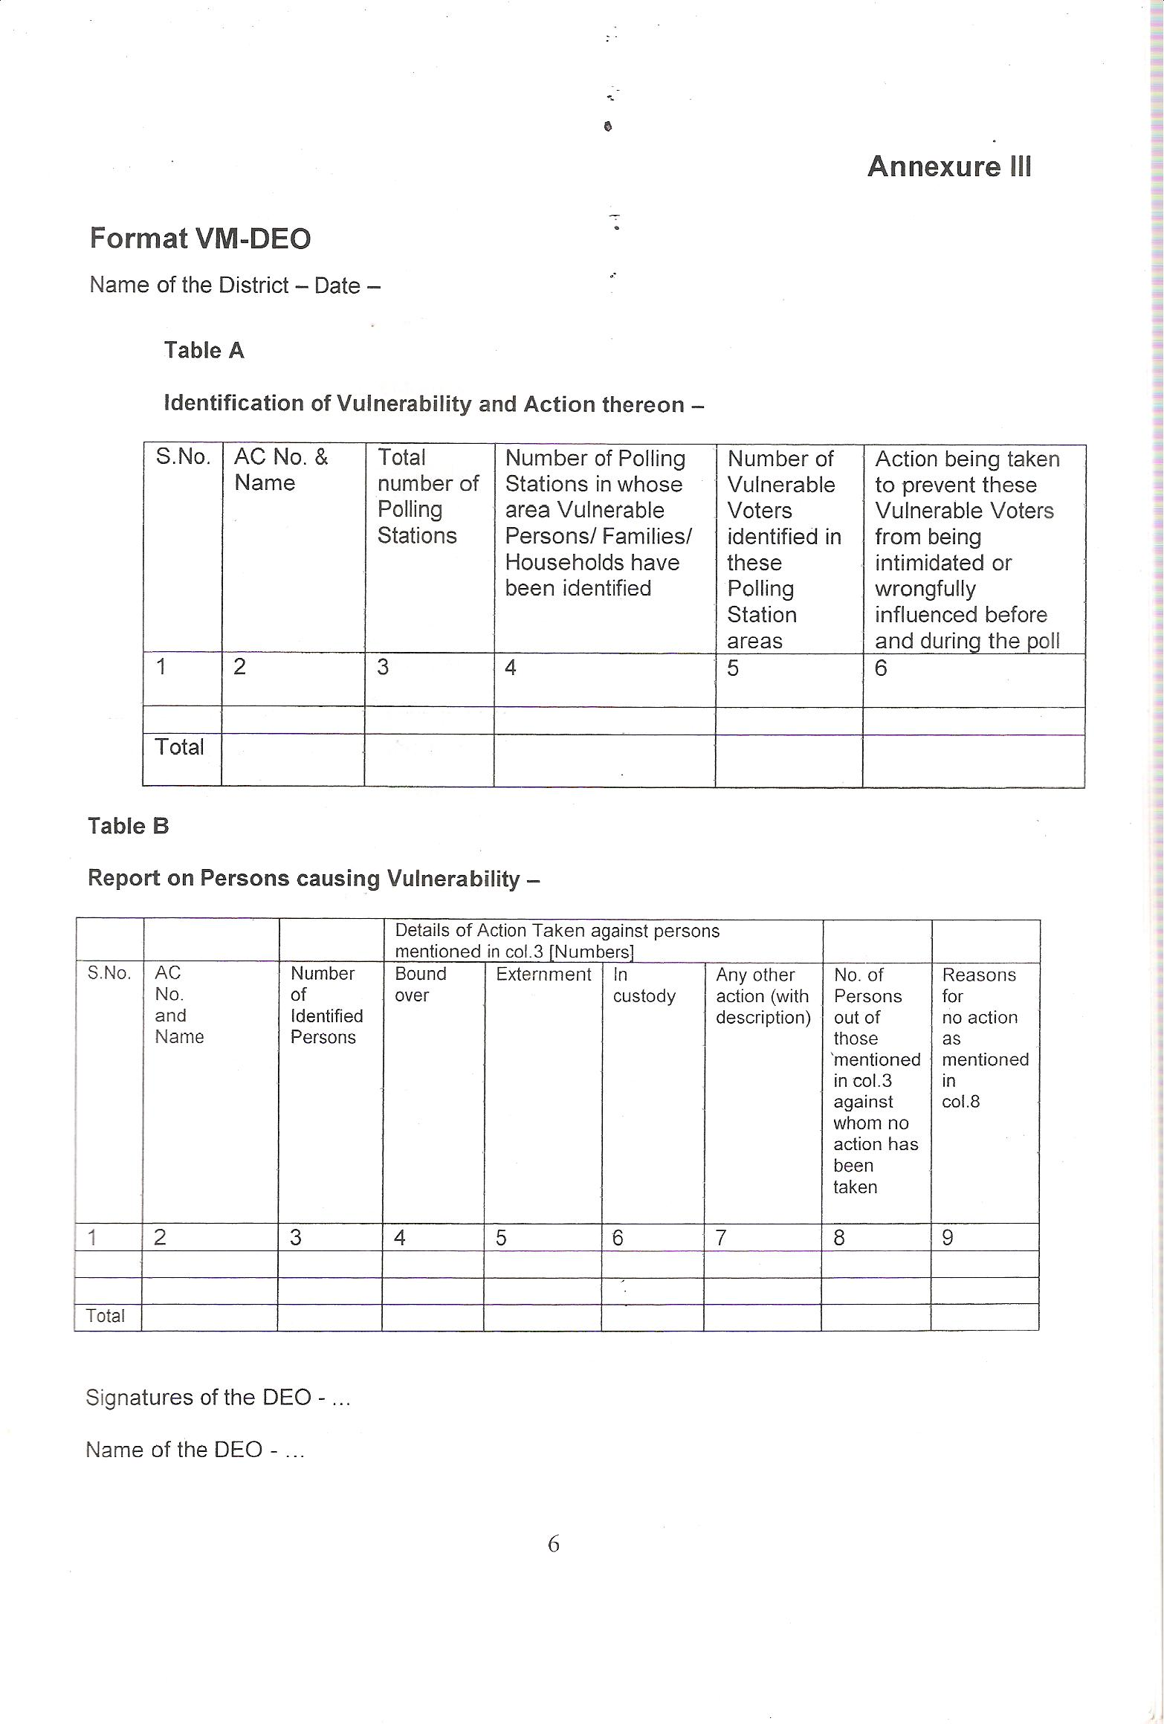
Sub Learning Objective 4: To list the Information requisite for Vulnerability Mapping
Format for Submitting Information by DEO to CEO for AC- Annexure III- Additional Instructions
No. of PS where vulnerable families identified
Action being taken to prevent vulnerability
Reasons for no action taken
No. of persons identified against whom no action taken

Slide 10
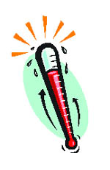
Sub Learning Objective 5: Criteria for Critical Polling Stations
Polling stations where more than 75% of votes recorded for one candidate
Polling station that went for re-poll during last election due to reported electoral malpractices
Polling stations that witnessed any sort of electoral violence in past election
Polling stations with high numbers of voters with no family linkages
Polling stations with high number of non-EPIC voters

Slide 11
Sub Learning Objective 6: Response Protocol for Critical Polling Stations
DEO & SP shall initiate all preventive measures & confidence building measures
Tours to vulnerable areas and explain measures put in place for protection
DEO & RO shall interact with candidates & political parties to gather feedback
DEO & SP finalize joint plan of action to deal with potential threats
-Binding trouble mongers under appropriate laws
- Preventive detention if required
- Forcing appearance in local stations to ensure good behaviour
- Placement of Police pickets
- Regular visits
District Intelligence shall give regular feedback on critical polling areas and incidences to DEO through SP
Dedicated Police teams/squads in convenient vicinity of clusters of vulnerable pockets
Observers will be provided list of critical PS and will visit the same & constantly monitor developments

Slide 12
Summary of Learning Objective : To ensure the carrying out of Vulnerability Mapping
Now You will be able to:
1
Answer What is Vulnerability
2
Answer What is Vulnerability Mapping
3
List the personnel involved in & Process of Vulnerability Mapping
4
List the Information requisite for Vulnerability Mapping
5
List criteria for identifying Critical Polling Stations
6
List steps of Response Protocol at Critical Polling Stations

Slide 13
IMPORTANT ECI INSTRUCTIONS ON VULNERABILITY MAPPING

Slide 14
Preventive Law and Order actions for peaceful, free and fair elections
[No. 464/L&O/ 2007 PLN-I dt. 8.1.2007]
Special drives to be launched from the announcement - (i) to compile list of persons indulged in electoral offences during past two elections (ii) updating list of history sheeters, declared absconders, fugitive criminals (iii) to give affect the service of pending warrants/challans and updating list of pending warrants, (iv) to expedite the investigation/prosecution of pending electoral offences (v) unearthing of illicit liquor factories (vi) seizure of illegal arms and ammunition etc.,.

Slide 15
Fortnightly updated constituency wise information on above special drives be kept ready with DEO to be forwarded to ECI, if and when asked for.
Prohibitory orders u/s 144 CRPC banning the carrying of licensed arms - 100% scrutiny of arms licenses.
Order relating to use of loudspeakers.
Immediately after announcement of election review of license holders.
Depositing of arms and ban on issuing of new arms license after announcement of elections.
Strict vigil and thorough checking of vehicles from 3 days before the poll till counting of votes to ensure that no undesirable elements or arms and ammunitions are being transported from outside.

Slide 16
Preventive actions u/s 107/116/109 CRPC
Sending proposals to Law Department for vesting powers of special executive magistrates and appointment of special executive magistrates.
Daily Law and Order report for the district in format prescribed in format LOR-1 be sent to Home department and not directly to ECI - Home department shall send a consolidated report on entire State in format LOR-2 to the CEO for onward submission to ECI - Daily report regularly from notification of elections till completion of elections.

Slide 17
Security force deployment Plan (ECI's No. 464/INST/2008-EPS dt. 24.10.2008)
Security Plan - [ECI's No. 464/L&O/2007 PLN-I dt. 8.1.07 and No. 464/INST/2008 - EPS dt. 24.10.2008]
(i) Full and optimal utilisation of CPFs and SAPFs to be ensured.
(ii) CPF can be splitted into half section - (SP to certify that the area is insurgency / naxalite free). In areas which are insurgency/ militancy/ naxalite affected, section of CPF not to be broken.
(iii) State deployment plan - To be prepared in consultation with CEO taking account the available forces of State Police/SAPF and CPF which will be made available by the MHA.
(iv) District deployment plan - To be prepared under the chairmanship of DM/DEO - and to be approved by Observers - No deviation without express prior approval of Observer.
(v) State deployment plan and district deployment plan would be finalised at least one week before the poll.
(vi) Observers to be given draft force deployment plan on their arrival.

Slide 18
The plan should have sketch map of each sector and identify vulnerable pockets and critical PSs.
(viii)Police patrol routes and SOs route to the extent possible should be common.
(ix) Deployment of any force (other than State Police and CPF) i.e. Home Guards etc., will require prior permission of ECI.
(x) Security cover to contesting candidates only as per assessment of threat, and not in routine manner - Observers should be provided with adequate security.
(xi) Three tier cordoning system to be set up in counting centres (ECI's No. 470/2007/PLN-I dt. 11.1.2007).

Slide 19
Sealing of inter state borders/inter district borders, well in advance to prevent infiltration of antisocial and disruptive elements.
For guarding strong rooms after the poll to the extent possible, CPF will be used and wherever CPF is not available SAP will be used.
The forces shall be deployed at the PSs in the following order of sensitivity - CPF followed by SAP followed by DAP (ECI's No. 464/L&O/2007 PLN-I dt. 8.1.07).
Additional measures at critical polling stations - As per criteria [ECI's No. 464/INST/2008-EPS dt. 24.10.2008]

Slide 20
Role of CPF and State Police (ECI's No. 464/INST/2008-EPS dt. 24.10.2008)
CPF not to be kept as strike reserve etc.,.
CPF will be used for the purpose of area domination, conducting flag march (should be more on foot), confidence building among electors, checking of border etc., till 2 days before the poll.
For the poll day the CPF shall be assigned duties of guarding PSs, poll material, poll personnel and the poll process and not to look after law and order - CPF may be deployed in any of the following manners: -
(a)Static guarding of chosen polling stations solely and exclusively by CPF;
b)Static guarding of polling stations as part of a mixed (composite) team with local state forces;

Slide 21
c) Patrolling duty on assigned routes (election sectors) covering a fixed cluster of polling stations;
(d) Patrolling duty as ‘flying squads’ in a defined area with surprise element;
(e) Escorting duty of polled EVM with polling personnel back to the receipt centre/strong room after polls are over;
(f) Any other duty which is necessitated to ensure the purity and fidelity of the election process.

Slide 22
In static duty at chosen PSs - One CPF Jawan from the CPF party posted at PS will be stationed at the entrance of PS to watch on the proceedings inside the PS - he will cover other PS also in same building.
(i) Where CPF has been assigned static guard duties but could not reach the assigned PS, the poll shall not commence.
(ii) Local State Police for maintenance of general law and order.
(iii) Local police not to replace the CPF at PS where the CPF has been assigned duties solely and exclusively - Supervision and control over the CPF at PS not by local Police Officer.

Slide 23
Hamlets/habitations with in polling area that are vulnerable to threat, intimidation and undue influence shall be identified and confidence building and preventing measures be taken in advance by local state police.
(iv) Only if enough CPF is not available, local State Police can be deployed at PS.
(v) A minimum two unarmed local State Police personnel/Home Guard for each PS - When a PS is covered with CPF unit, only one local police will be deployed.

Slide 24
CPF mobile patrolling party will be provided sketch map and list of critical polling stations.
(xii) When the CPF is assigned duty in a "flying squad" mode, it shall be accompanied by a Zonal Magistrate.
Amenities to CPF personnel
(a) Food arrangements to be made at par with those of the State Police/Polling personnel
(b) Packed lunch on poll/counting duty
(c) Accommodation - as prescribed.
(d) Vehicle / transportation
(e) SIM card to Coy. Commanders

Slide 25
Identification of critical polling stations
[ECI No. 464/INST/2008-EPS dt. 24.10.2008] Factors to be taken into account
PSs of high % of Non EPIC voters.
PSs of high % of missing voters without family links.
PSs having vulnerable pockets - SO's, Police's and candidate's "worry list".
PSs where polling was more than 75% and where more than 75% of votes have been polled in favour of one candidate in last election.
Re-poll reported due to malpractices, and where electoral violence has taken place during last election (NOT including re-polls due to EVM malfunction).

Slide 26
Anti social elements and their areas of influence.
Observer shall be consulted before finalizing the list of critical PS.
Categories of critical PSs - like S-1, S-2, S-3 and S-4. Weight-ages to be assigned to each category of criticality.

Slide 27
Critical Polling stations - Measures to be followed [ECI No. 464/INST/2008 - EPS dt. 24.10.2008 and No. 447/2007/PLN-4 dt. 17.1.2007]
One or all of the following measures: —
CPF to safe guard the PS.
PrOs be briefed to ensure that the EPIC/ alternative identification documents are properly verified and reflected in the remarks col. of Form 17A
List of such PSs be given to Commanding/ Assisting Commanding Officer of CPF to keep an eye on such PSs.

Slide 28
Digital/Video camera be positioned at identified PSs as directed by the ECI - Photography be carried inside the PS to capture photos of all electors in same sequence as in Form 17A and cover poll proceeding without compromising the secrecy of voting - Special care about the faces of all electors without EPIC or other ECI approved photo identity card.
Micro Observer to be deployed - with consultation / approval of Observer.
Critical events in and around the PS should also be captured/photographed
Digital cameras will be issued by DEO to the trained officers for such PSs - The officer shall submit a certificate after the poll as prescribed.

Slide 29
Prevention of Intimidation to the voters – Vulnerability Mapping
[ECI No. 464/INST/2007 - PLN-I dt. 12.10.2007] and 464/Instructions/EPS/Dt. 5th March, 2011
  For identification of the areas Sector officers, should do exercise by visiting the area soon after declaration of election - SHO and local administrative officers be consulted before the finalizing the list - [Candidates' "Worry List" also to be considered when candidates are finalized and observers have arrived].
  Source of such threat / intimidation and names of persons who likely to spearhead such offence of undue influence be identified - Past incidence and current apprehensions.

Slide 30
Pre-poll responsibility - About vulnerability mapping –
Frequent visits for confidence building measures and fine tuning the vulnerability mapping;
Vulnerability Mapping (ECI No. 464/INST/2007 PLN I dt. 12.10.07)
Identification of villages, hamlets and segments of voters vulnerable for threat and intimidation

Slide 31
Identification of persons who make it vulnerable - "It is not about numbers- it is about names" - Information to be given in prescribed format to the RO/DEO without having to disclose the source, [confidentially, if so required].
Accountability for ensuring free access of voters for voting.
Contact points within the vulnerable community with their telephone numbers
SO will act as Zonal Magistrate and therefore he will accompany the police forces during area domination.

Slide 32
Since SO will act as Zonal Magistrate, he will prepare a "Zonal Magistrate Plan" sketch map of zones/ routes/ PSs, list of telephone Nos of PSs and election related officers, police stations etc., list of responsible persons and list of Anti social elements and people to be kept under 'special watch‘.

Slide 33
  Contact points within the habitats / community vulnerability, be identified - Mapping for entire constituency polling station wise in a format (enclosed)
  Preventing measures by DEO and SP and confidence building measures for free and fair poll - Frequent visit at such locations.
  Regular feedback by district intelligence - DEO / RO shall interact with candidates / political parties.
  Details of PS wise vulnerability mapping be given to Observer also on his arrival.
  Action plan by DEO and SP to deal with potential threats and intimidation points - action under 107 / 116 / 151 CRPC, forcing trouble mongers' appearance in police station, placement of police pickets, visits by officers etc.,.
  On the day of poll special attention be given - In case some section of voters is conspicuously absent special squad will be sent to ascertain that there is no hindrance.

Slide 34
  At the end of poll SO to submit special report to RO that voters from vulnerable habitats were able to vote or not.
  Polling parties should also be briefed about the vulnerable centers - section in electoral part of the area be marked specially.
  CPF shall be given a list of such vulnerable locations - CPF shall also make it a point to visit for confidence building measures.
  If ordered by ECI, Observer will make a reading of the Form 17A and the marked copy of the electoral roll used at the PS.

Slide 35
THANKS

